Slide 1
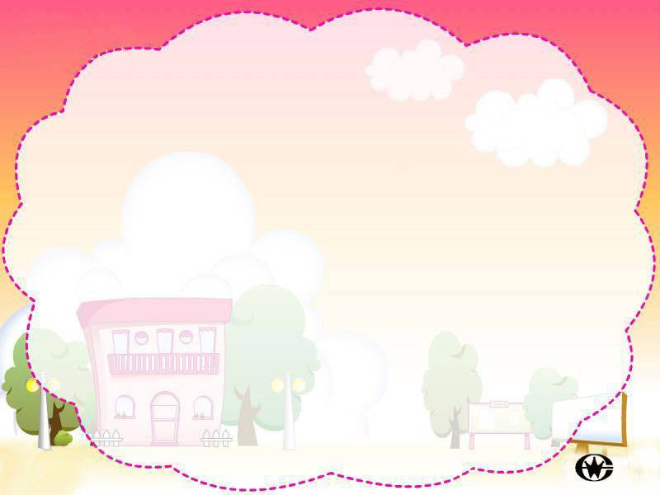
Reading

Slide 2
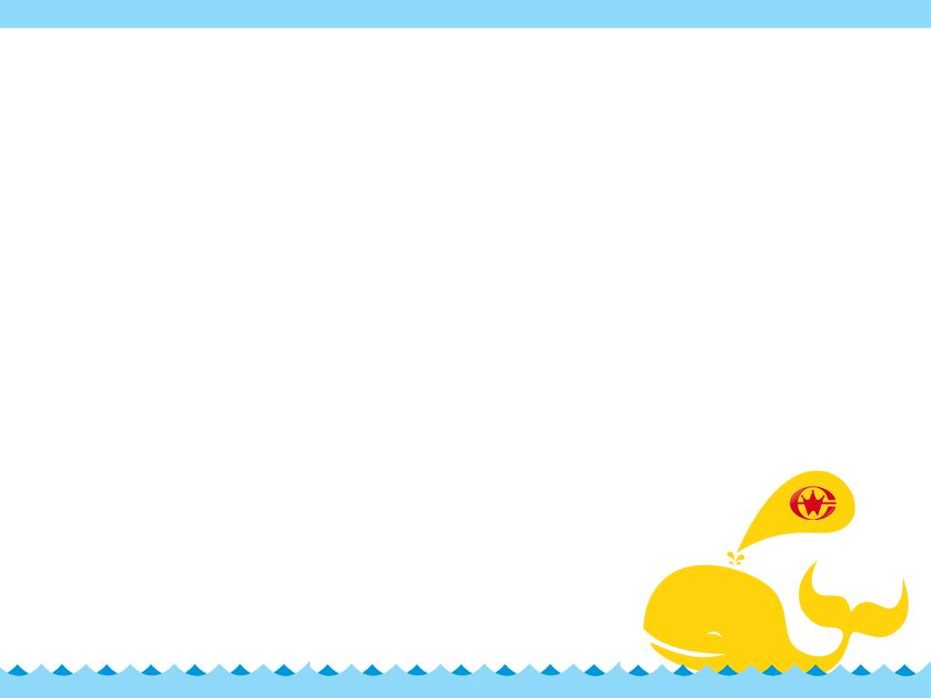
Festivals around the world
National Day
Christmas
New Year
…
Father’s Day
What festivals do you know?
Army Day
FESTIVAL
Mid-Autumn
Festival
May Day
Children’s Day
Spring Day
Teachers’
Day
Dragon
Boat
Festival
Mother’s Day

Slide 3
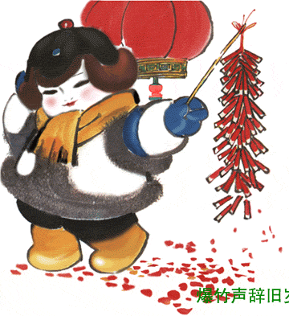
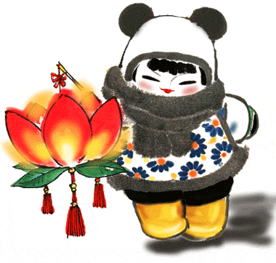
When do they take place? lunar calendar
Spring Festival
January 1
Lantern Festival
January 15

Slide 4
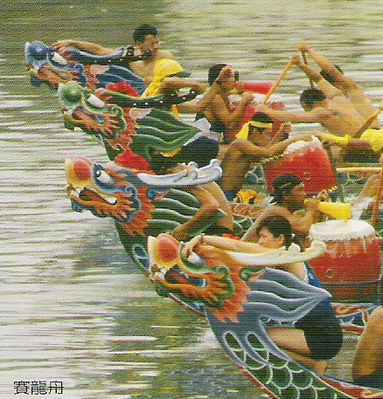
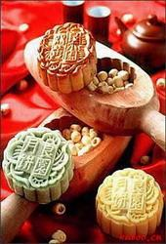
Dragon Boat Festival
May 5
Mid-autumn Day
August 15

Slide 5
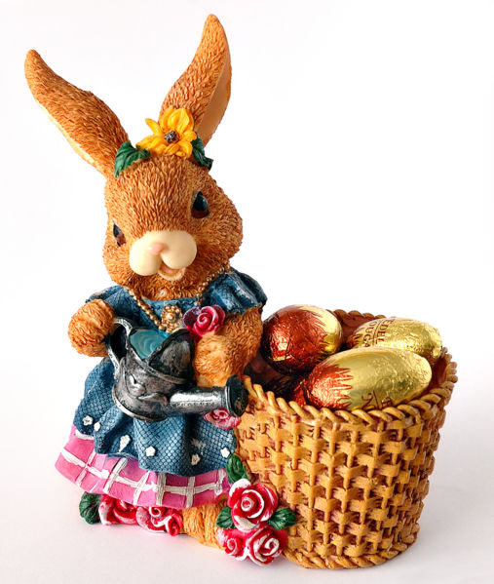
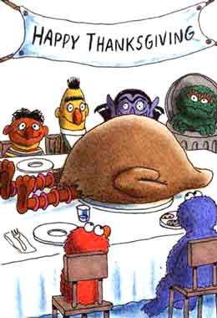
Easter
around March 22---April 25
Thanksgiving Day
the last Thursday of November

Slide 6
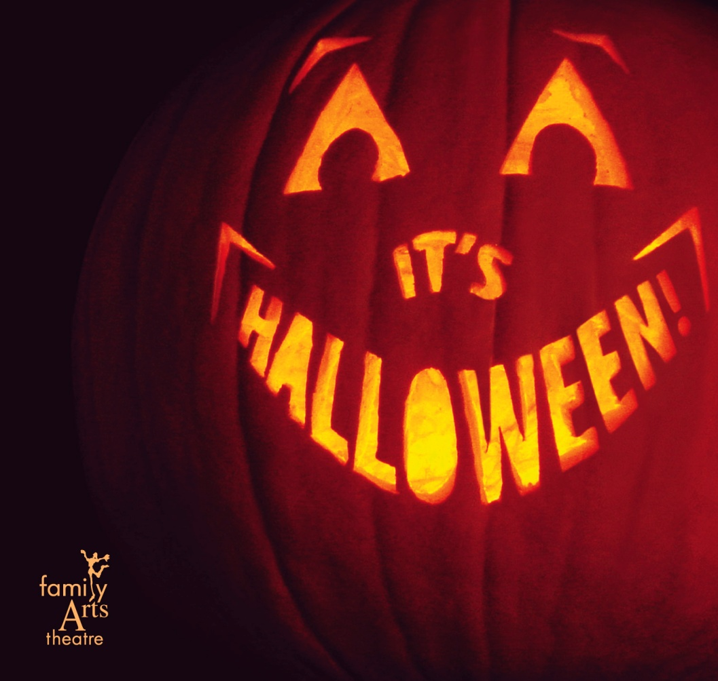
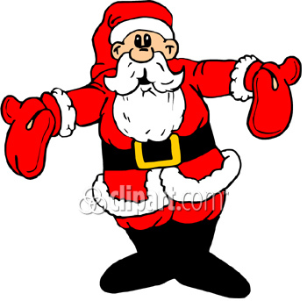
Halloween
October 31
Christmas Day
December 25

Slide 7
Choose one of the festivals, and think about:
What people should do or not do
What it celebrates
Date
Food
Work
Fruit
Jiaozi
Visit
FESTIVALS
Fun
Dress up
Memory
Watching TV
Singing
Dancing

Slide 8
Sample:
Spring Festival
We celebrate the end of winter, arrival of spring, Lunar New Year, reunion with family and relatives. During Spring Festival, people give money in red paper to children; see dragon dances; eat fish, prawns and dumplings; visit family member.

Slide 9
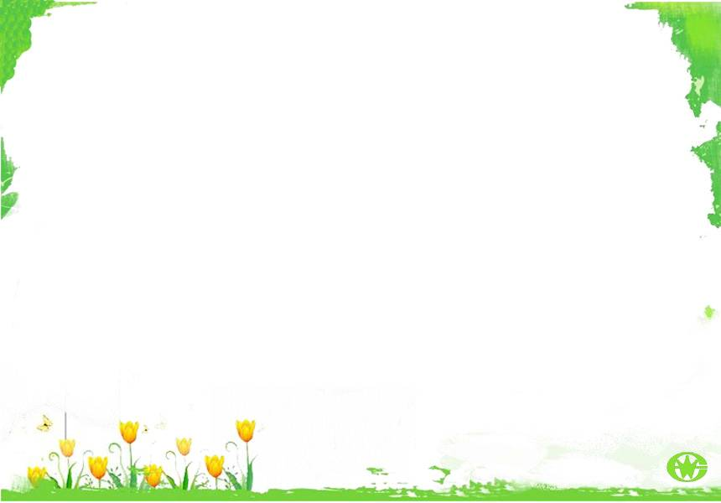
Pre-reading
Work in groups of four and talk about the two question.
1. What festivals or celebrations do you have in your city or town? What part of a festival do you like best- the activities, the music, the sights, the food or the people who visit?

Slide 10
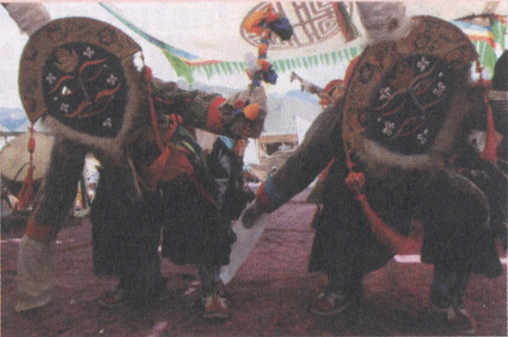
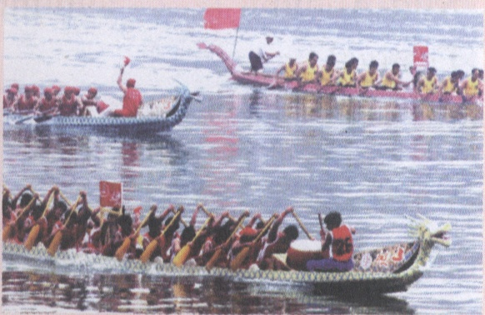
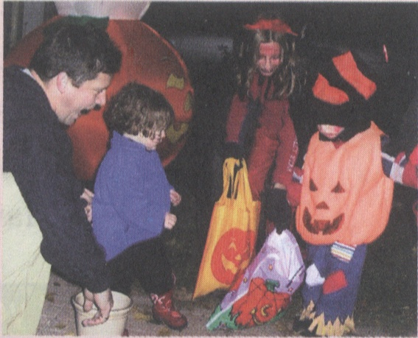
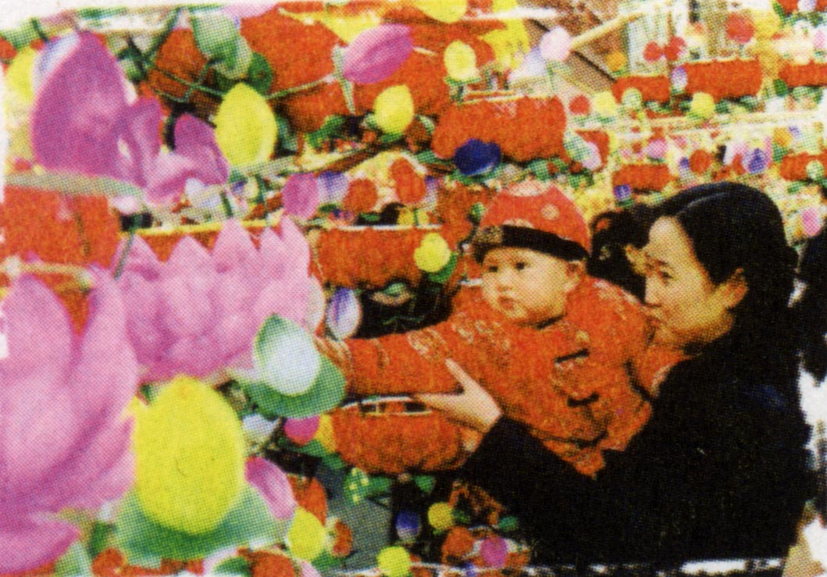
2. Look at the pictures and title of the passage below. Discuss what kind of information you think will be introduced in the passage.

Slide 11
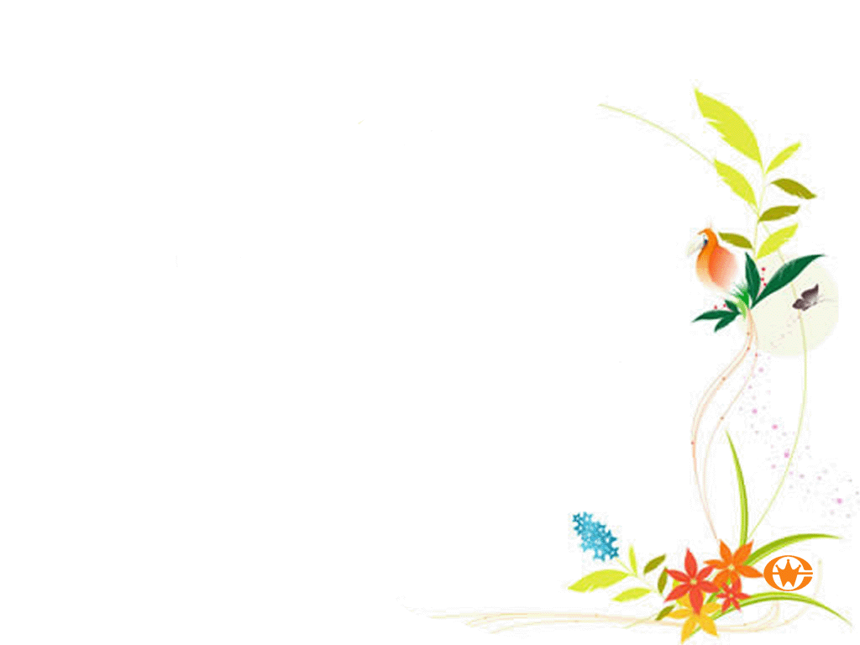
New words
starve: 饥饿
origin: 起源
ancestor: 祖先
Obon: 盂兰盆节(日本)
grave: 坟墓；墓地
incense: 熏香
in memory of: 纪念
feast: 节日；盛宴

Slide 12
skull: 头骨
dress up: 打扮；盛装
play a trick on: 搞恶作剧
award: 奖品
rooster: 公鸡
energetic: 充满活力的
carnival: 狂欢节
parade: 游行

Slide 13

Scanning
Read through the passage and find out how many types of festivals are mentioned in the passage?
1. Ancient festivals
2. Festivals of the Dead
3. Festivals to Honor the People
4. Harvest Festivals
5. Spring Festivals

Slide 14
Skimming
What festivals are mentioned in each paragraph and?
Para. 1 Ancient Festival
celebrate the end of the cold weather, planting in spring and harvest in autumn; celebrate when hunters catch animals.

Slide 15
Para. 2 Festivals of the Dead
Japan -----Obon
Mexico------Day of the Dead
America------Halloween
Para. 3 Festivals to Honour People
China ----- Dragon Boat Festival
USA ----- Columbus Day
India ----- festival to honour Gandhi

Slide 16
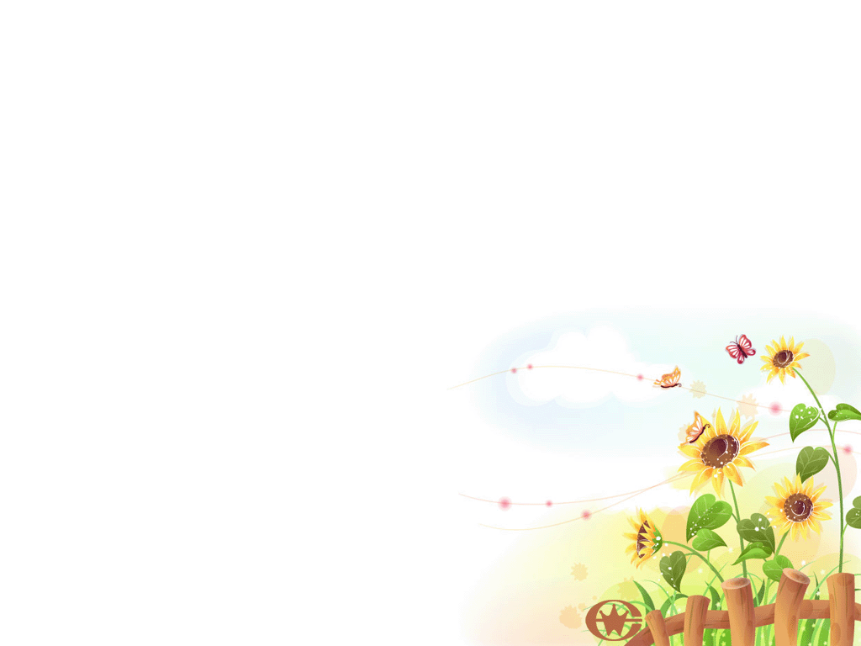
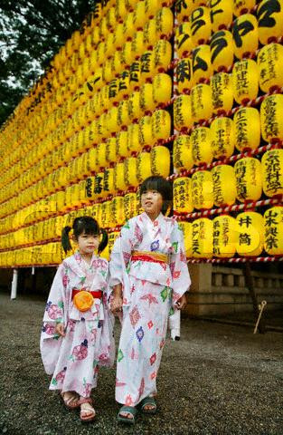
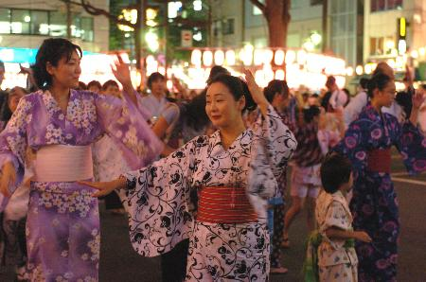
Obon（盂兰盆） in Japan

Slide 17
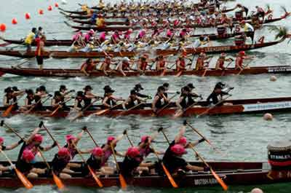
Dragon Boat Festival

Slide 18
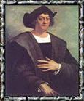
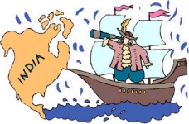
Columbus Day

Slide 19
Para. 4 Harvest Festivals
European and other countries ----- Harvest and Thanksgiving Festival
China and Japan----- Mid-Autumn festival
Para. 5
China ----- Spring festival
Some Western countries ----- Easter and related holidays
Japan ----- Cheery Blossom Festival

Slide 20

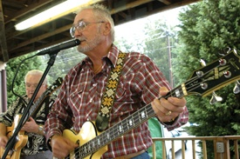
Harvest Festivals

Slide 21
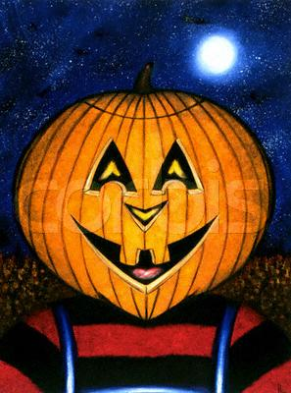

Halloween (万圣节)

Slide 22

Read the passage carefully again and answer the questions with the help of the pictures.

Slide 23
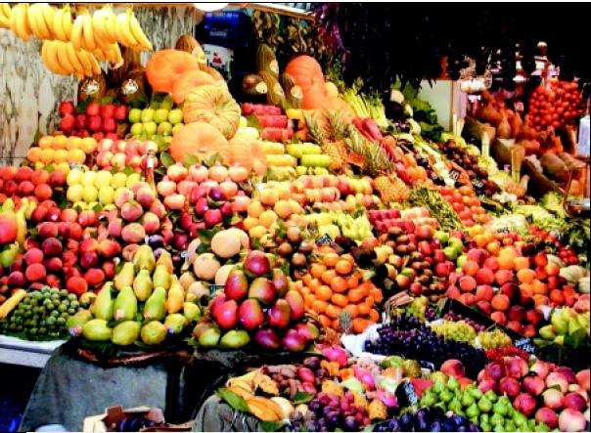
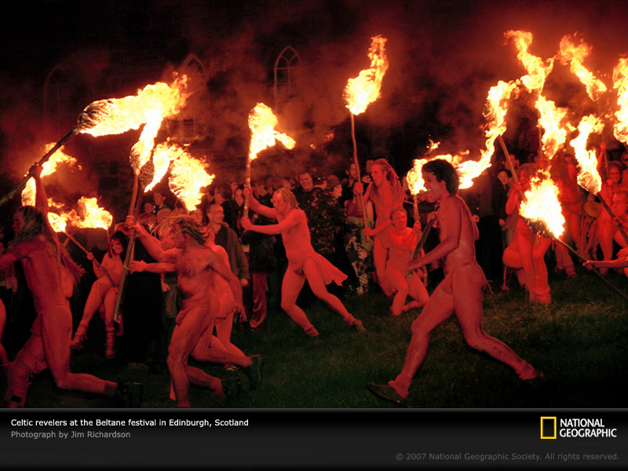
Ancient Festivals
What would people celebrate at these three times of a year?
Why do you think music and fire or light are used in festivals?

Slide 24
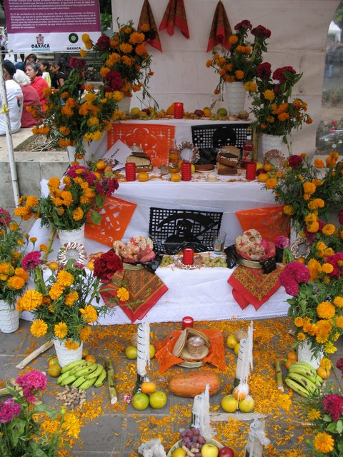
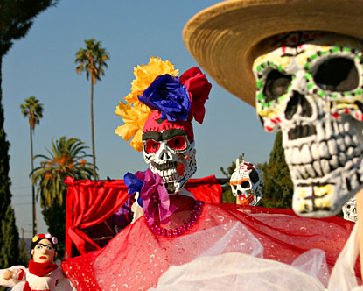
Mexican Day of the Dead
What kind of things are done to honour the dead?
Why do you think about the Mexican
practice of making cakes with skulls and bones?

Slide 25
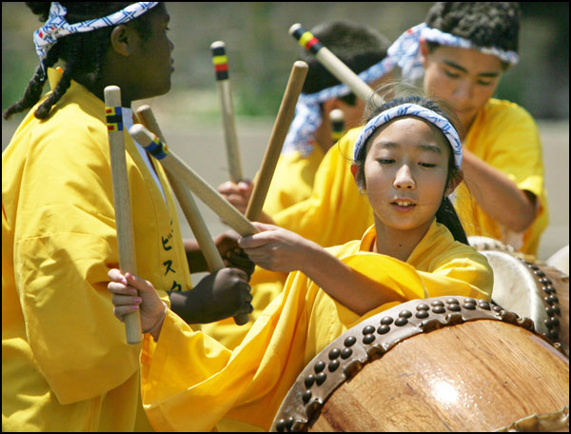
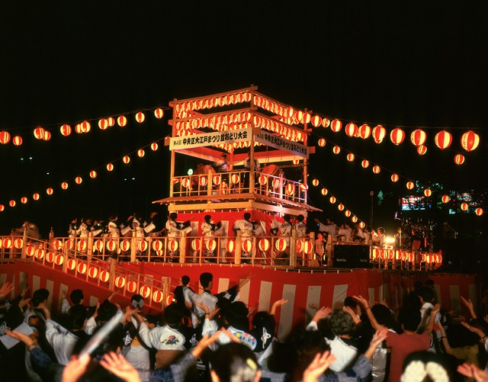
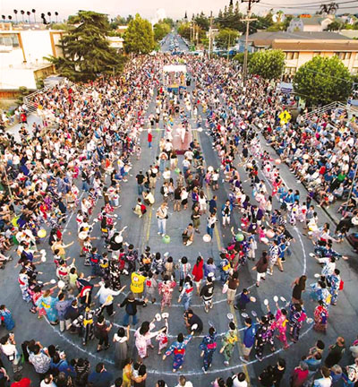
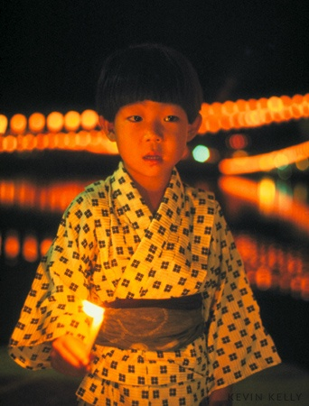
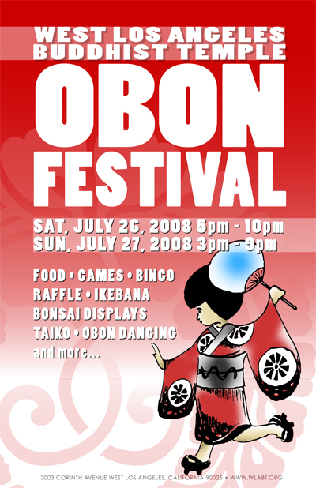
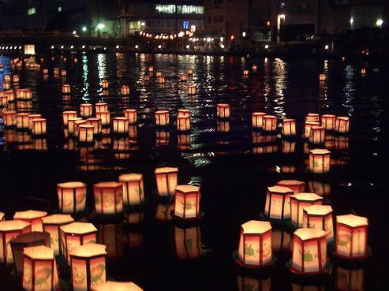
Obon

Slide 26
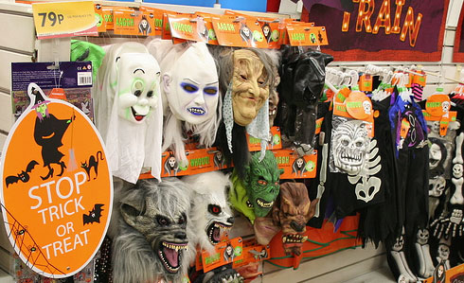
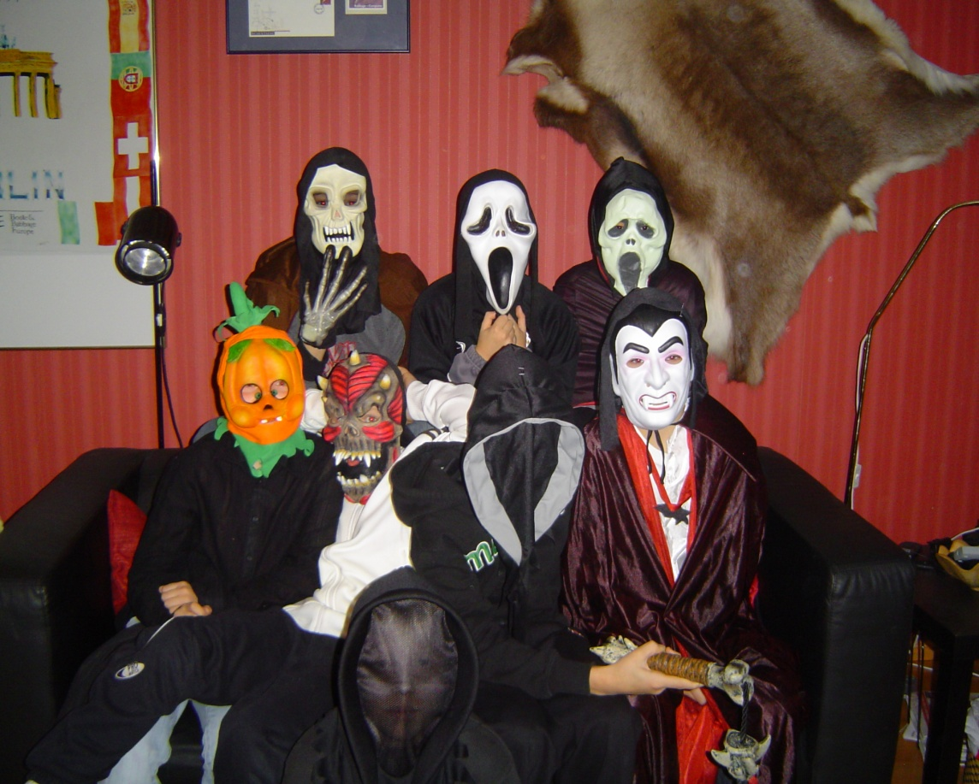
Halloween
What do you know about Halloween?

Slide 27
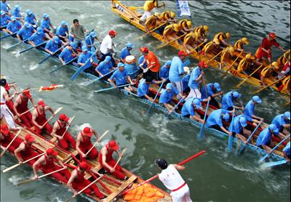
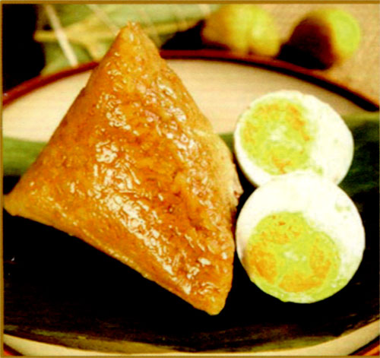
the Dragon Boat Festival
What festivals or celebrations can you think of that honour famous people or important events?

Slide 28
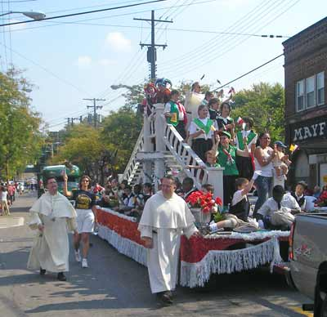
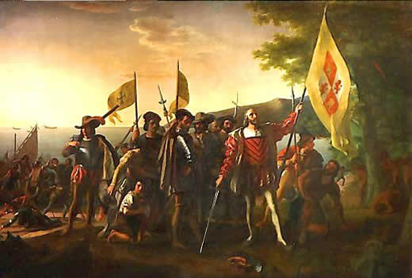
Columbus Day
Who do you think should have a festival to honour them? Why?

Slide 29
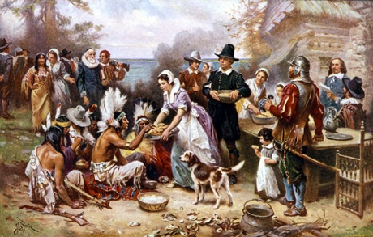
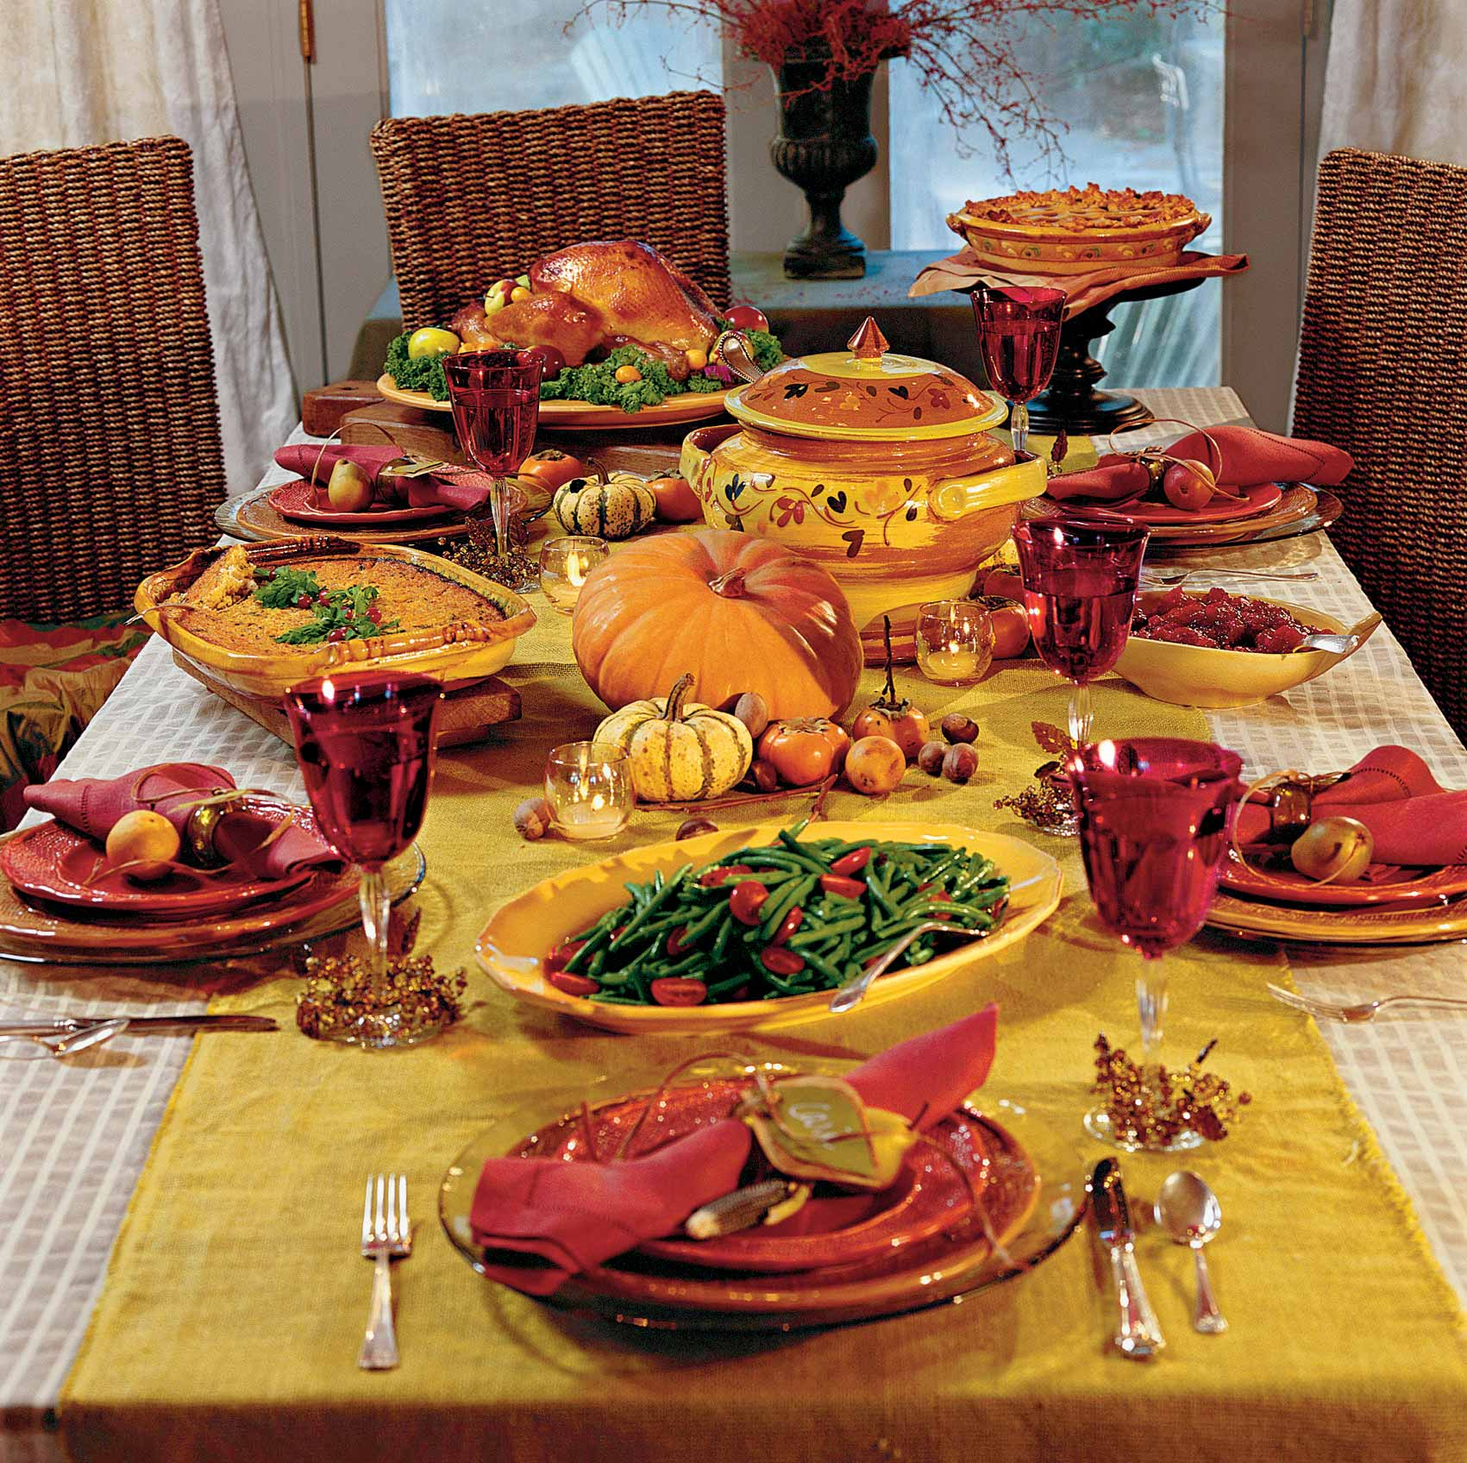
Harvest Festival Thanksgiving Day
Do you know any harvest celebrations in China?

Slide 30

Consolidation
I. Finish the tasks one by one according to the text.

Slide 31
1. Festivals of the Dead Fill in the blanks.
Purposes | To honor the dead or satisfy the 1________
Names | 2______ | The Day of the Dead | 9_________
Countries | Japan | 6_______ | Western countries
ancestors
Obon
Halloween
Mexico

Slide 32
Activities | Cleaning 3______; lighting 4_______ and lamps; playing 5______ | Eating cakes with 7_____ on them; offering food, flowers and 8____ to the dead | Children 10 _______ and ask for sweets
graves
bones
dress up
incense
music
gifts

Slide 33
2. Festivals to Honour People
Match the person with the festival.
1. Qu Yuan
2. Christopher Columbus
3. Mohandas Gandhi
a. the Dragon Boat Festival
b. an Indian national festival on Oct. 2
c. Columbus Day
a
c
b

Slide 34
3. Harvest Festivals
Choose the best answer.
Many activities can be held in harvest festivals EXCEPT that people ___.
A. get together to have meals
B. decorate houses to admire the moon
C. win awards for their farm produce
D. enjoy mooncakes
B

Slide 35
4. Spring Festivals Fill in the blanks.
Meanings | To look forward to the end of winter and to the coming of spring
Names | 1______ ____________ | 4 ______ | 7_____ | Cherry Blossom Festival
The Spring
Festival
Easter
Carnivals

Slide 36
Countries | China | Western countries | Mainly religious countries | 8 _____
Japan

Slide 37
Parades
Activities | Eating good foods; giving children 2_____ money; 3________ ______ and carnivals | 5________; dancing in the streets; loud music; 6_________________
lucky
colourful
clothing
dragon dances

Slide 38

II. Use the information from the reading passage to answer the following question.
1). What are festivals of the dead usually for?
Festivals of the dead are for honouring or satisfying dead ancestors or others, who some people believe might return to help or harm living people.

Slide 39
2). What makes autumn festivals happy events?
Autumn festivals are happy events because people are thankful that food is ready for winter and the hard farm work is finished.
3). What do people usually do at spring festivals?
At spring festivals, people usually have dances, carnivals and other activities to celebrate the end of winter and the coming of spring.

Slide 40
4).What is one important reason to have festivals and celebrations?
It is important to have festivals and celebrations so we can enjoy life/ be proud of our customs/ forget our work for a little while.

Slide 41
5). Compare the festivals of the dead in Mexico, Japan and China. What things are similar? What things are different?
The Chinese, Japanese and Mexican festivals of the dead all have customs to honour the dead. The Chinese and Japanese go to clean their ancestors’ graves, and the Mexicans offer food, flowers and gifts to the dead.

Slide 42
However, there are some difference. The Mexicans eat special food that looks like bones, something the Chinese and Japanese do not do.

Slide 43
6). What is one important reason to have festivals and celebrations?
Festivals let us enjoy life, be proud of our customs and forget our daily life for a little while.

Slide 44

III. True or False
1. The ancient people needn’t worry about their food.
2. Halloween used to be a festival intended to honor the dead.
F
T

Slide 45
3. Qu Yuan was a great poet who people honor a lot in China.
4. Mid-autumn Festival is held to celebrate the end of autumn.
5. Easter celebrates the birth of Jesus.
T
F
F

Slide 46

Discussion
Which festivals you think are the most important and which are the funniest.
 | Type of festival | Example of festival | Reasons for your choice
Most important
Most fun

Slide 47


CHECKING CORNER
选用合适的词或短语，用其适当形式
填空。
be meant to; take place;
at that time; beauty; harvest
1. A terrible accident __________ at the crossroads three days ago.
took place

Slide 48
be meant to; take place;
at that time; beauty; harvest
2. ____________, we didn’t have enough money to buy a car.
3. Millions of dollars are spent each year on ______ products.
At that time
beauty

Slide 49
be meant to; take place;
at that time; beauty; harvest
4. Even the youngest children would come and help to get the ________ in.
5. I ____________ be working on Sunday, but I just fooled around all day.
harvest
was meant to

Slide 50

Homework
1. Go over the text after class and try to write a summary of the text (about 100 words) and retell the text according to the summary.

Slide 51
2. Prepare for “discovering useful words and expressions” on Page 4. (Ex1, 2 and 3)
3. If possible try to find out as much information as possible about festivals around the world. You can surf the Internet or refer to the books.

